Slide 1

FGT
Revenue Planning System for
E-Commerce
RPSE Application
Asyraf Ilmansyah Hia
Purwadhika Startup and Coding School
Final Project

Slide 2
Project Mission

Slide 3
Project Mission
From the online shop dataset, we can learn that the e-commerce website visitors have many different behaviors. Normally the marketing budget is allocated to increase the revenue and the promotion budget is allocated to establish a brand. The e-commerce website marketers may can allocate the marketing budget inappropriately if they don't have an overview about the target. If the marketing budget can't give big impact to increase the revenue, the company might not achieve the target profit and at a time it can make the company bankrupt. The RPSE project's main mission is to reduce the risk of misallocation of marketing budgets by making machine learning based application to determine the revenue based on historical data.

Slide 4
Datasets

Slide 5
Datasets
The dataset is from Revenue Prediction System For E-Commerce (RPSE)
01
The Source
02
The Rows
Kaggle
“Can this target make revenue?”
by C. Okan Sakar & Yomi Kastro
12330 Rows of Data
https://www.kaggle.com/roshansharma/online-shoppers-intention
03
The Feature
04
Final of Features Selected
18 Features
11 Features
12330 rows

Slide 6
Machine Learning
Algorithm

Slide 7
Machine Learning Algorithm
Logistic Regression
Decision Tree Classifier
Logreg
DTC
Send part drawing and request quotation to vendor
01
02
K-Nearest Neighbors
KNN
RFC
Random Forest Classifier
Control and monitoring part quality and regular delivery.
Vendor selection and doing a negotiation to preferably vendor
06
03
Developt and control vendor to meet KMI’s new model preparation.
GBC
ABC
Send the letter of intent to chosen vendor as a agreement.
Gradient Boost Classifer
05
04
Ada Boost Classifier

Slide 8
Evaluation Method
01
Confusion Matrix, Precision & Recall
02
ROC & AUC

Slide 9
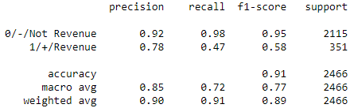

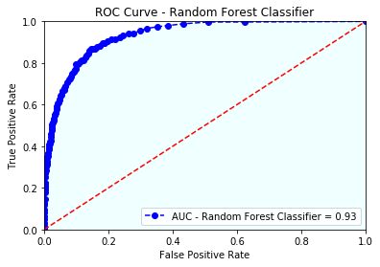
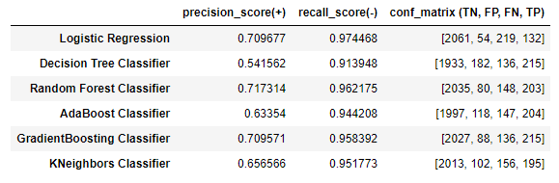
Chosen Algorithm
Random Forest Classifier
Confusion Matrix
Classification Report
Prediction
No Yes
No
Yes
Actual
AUC Graphs
Classification Report Comparation

Slide 10
Flask Application

Slide 11
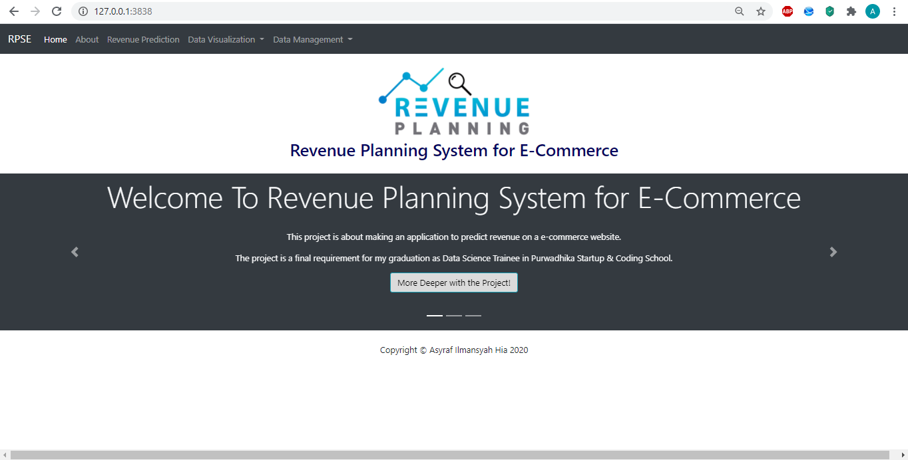
Home Interface

Slide 12
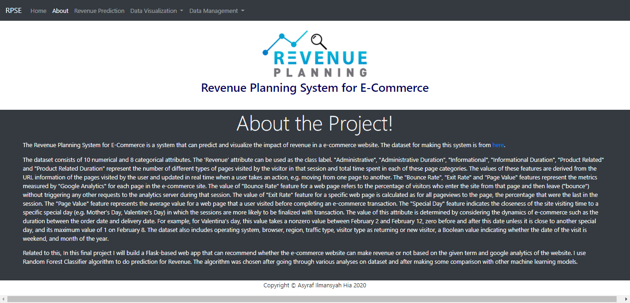
About Interface

Slide 13
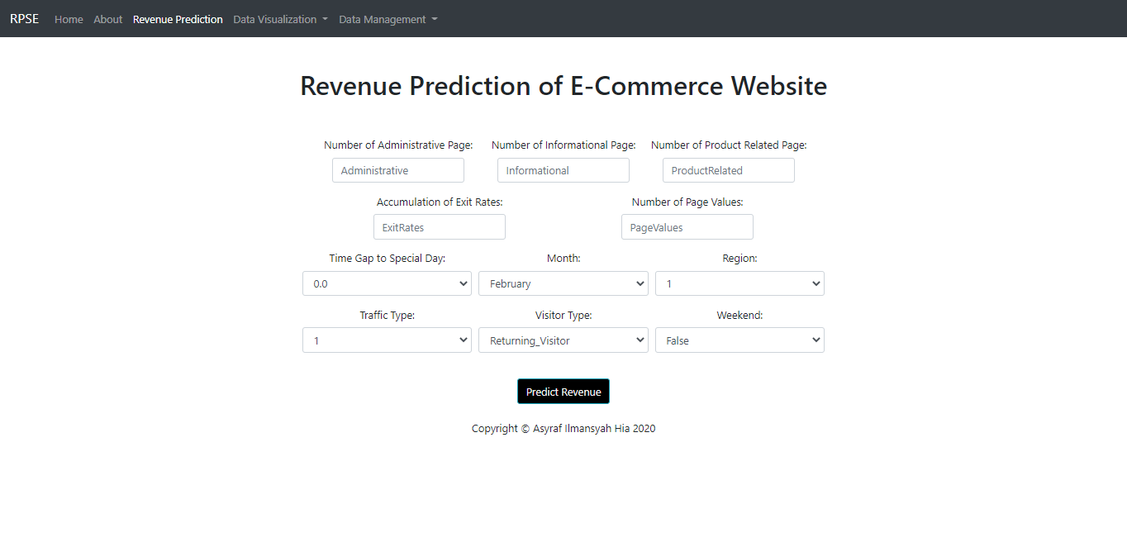
Prediction Interface

Slide 14
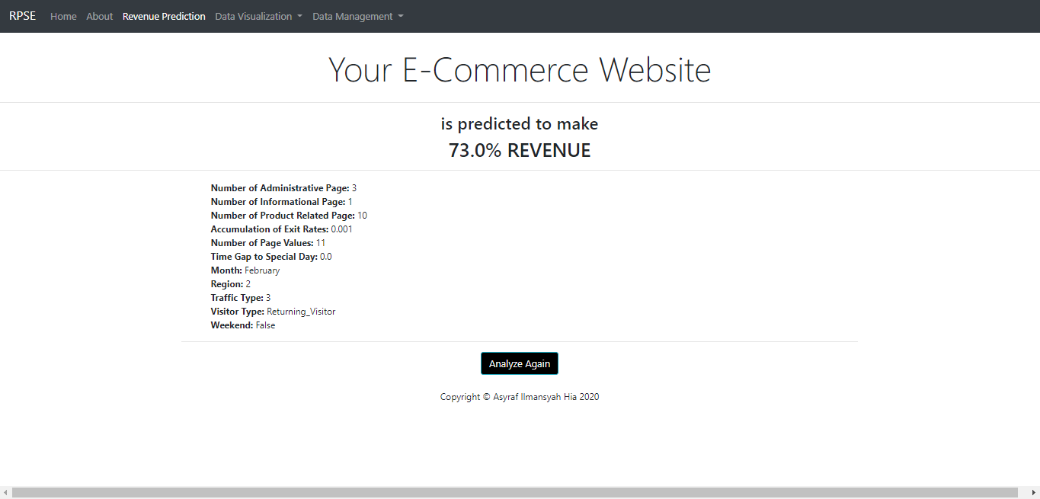
Result Interface

Slide 15
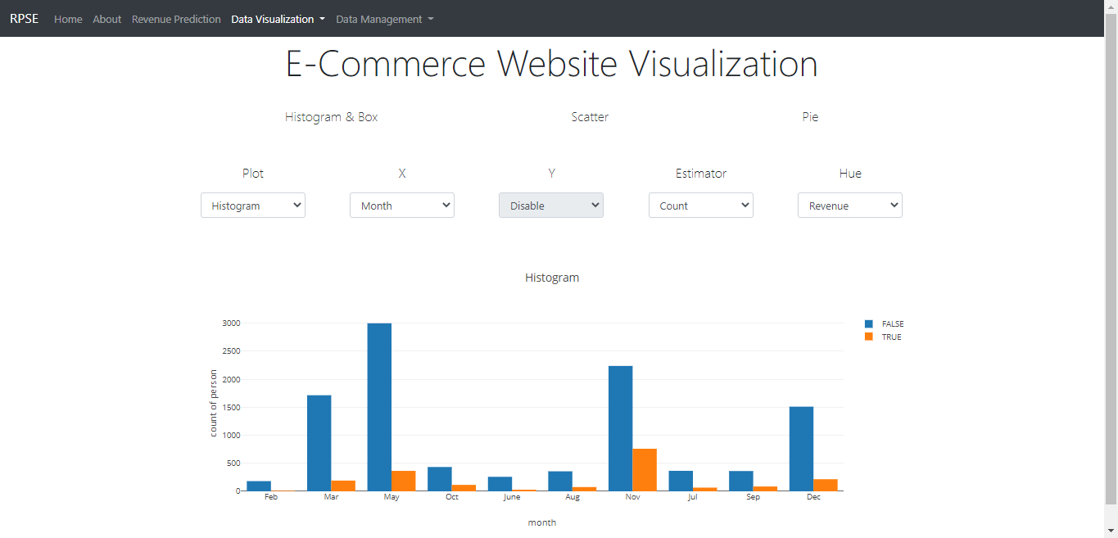
Data Visualization Interface

Slide 16
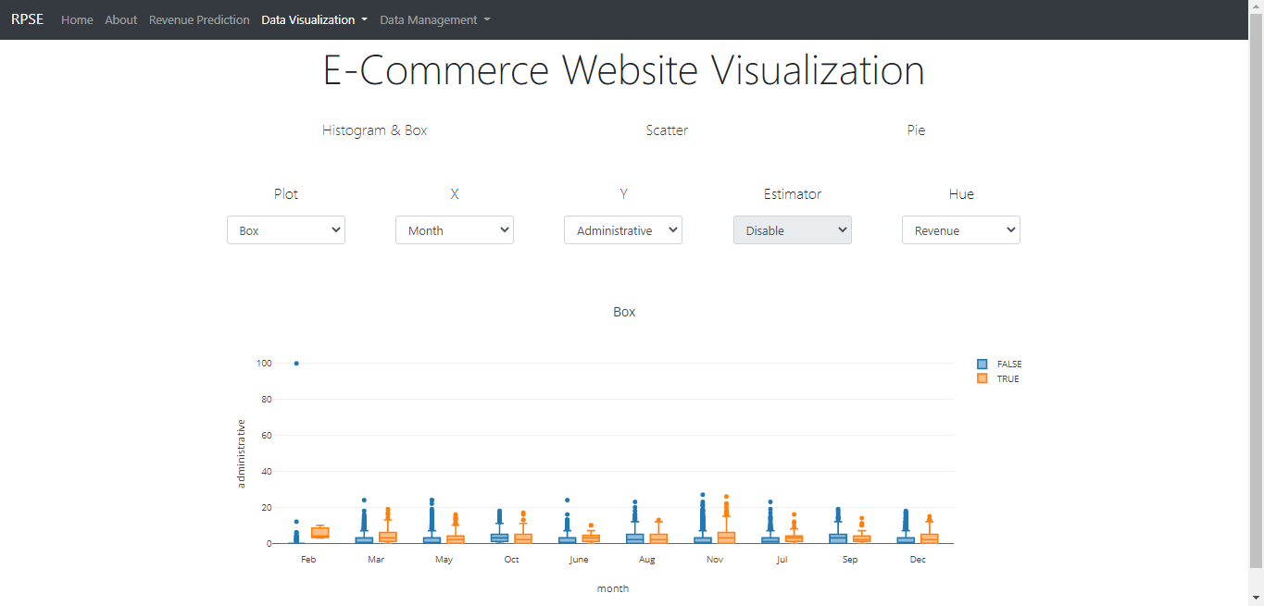
Data Visualization Interface

Slide 17
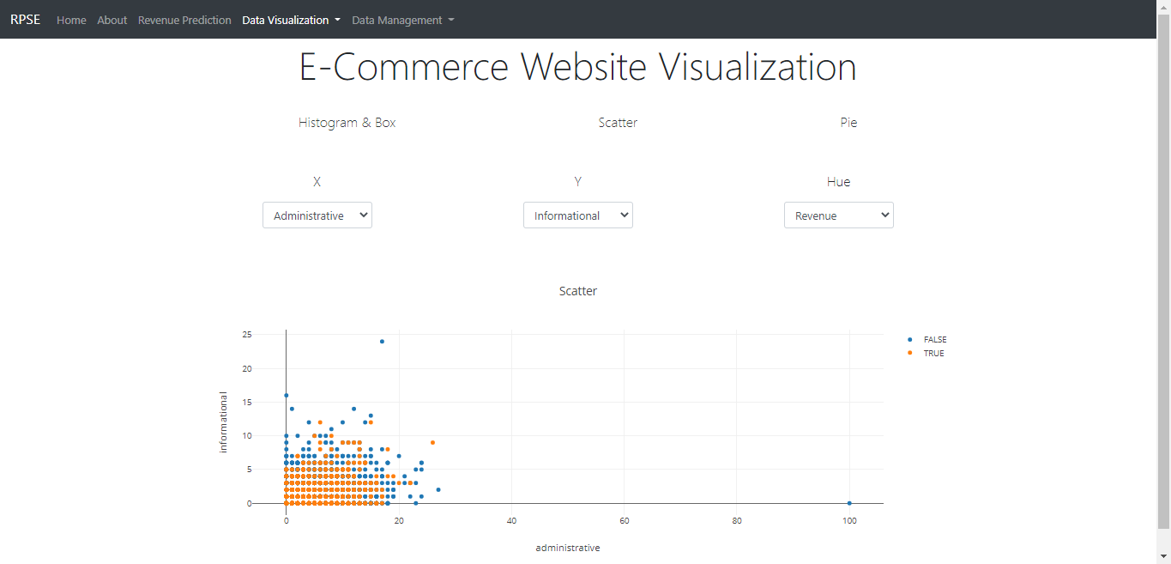
Data Visualization Interface

Slide 18
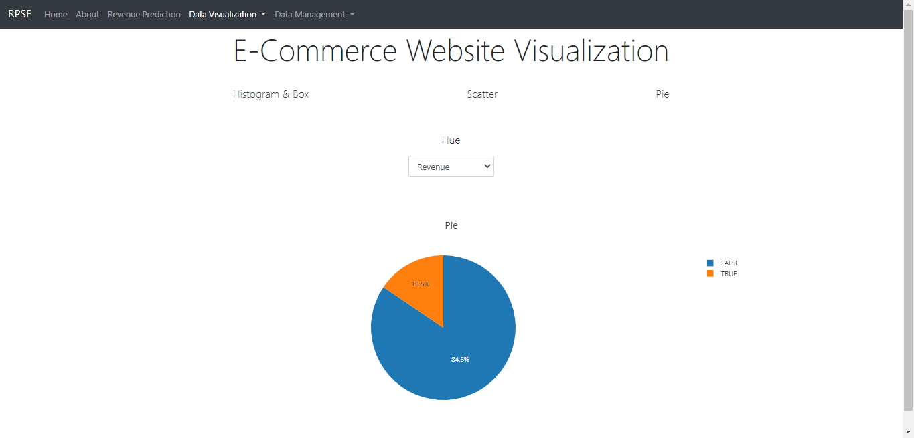
Data Visualization Interface

Slide 19
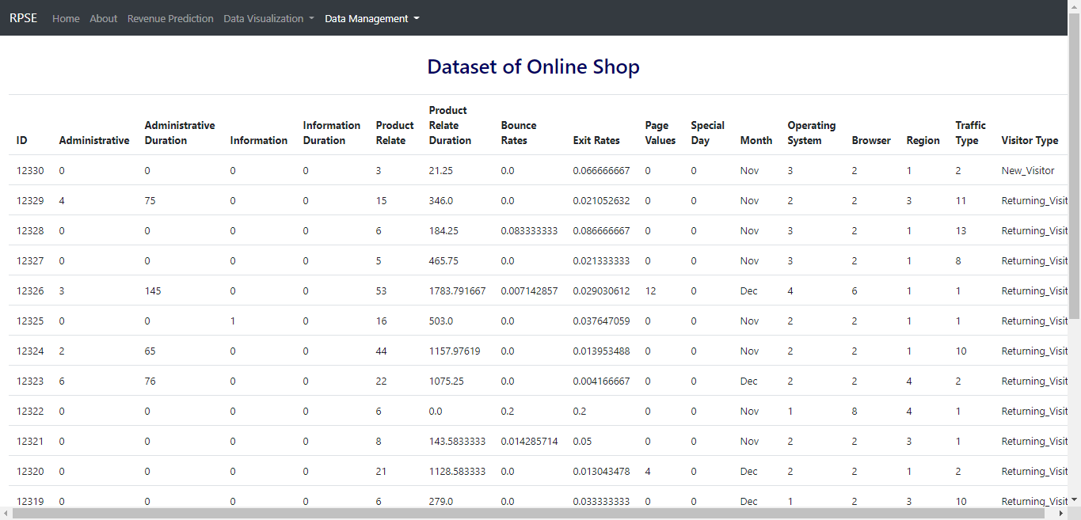
Data Management Interface

Slide 20
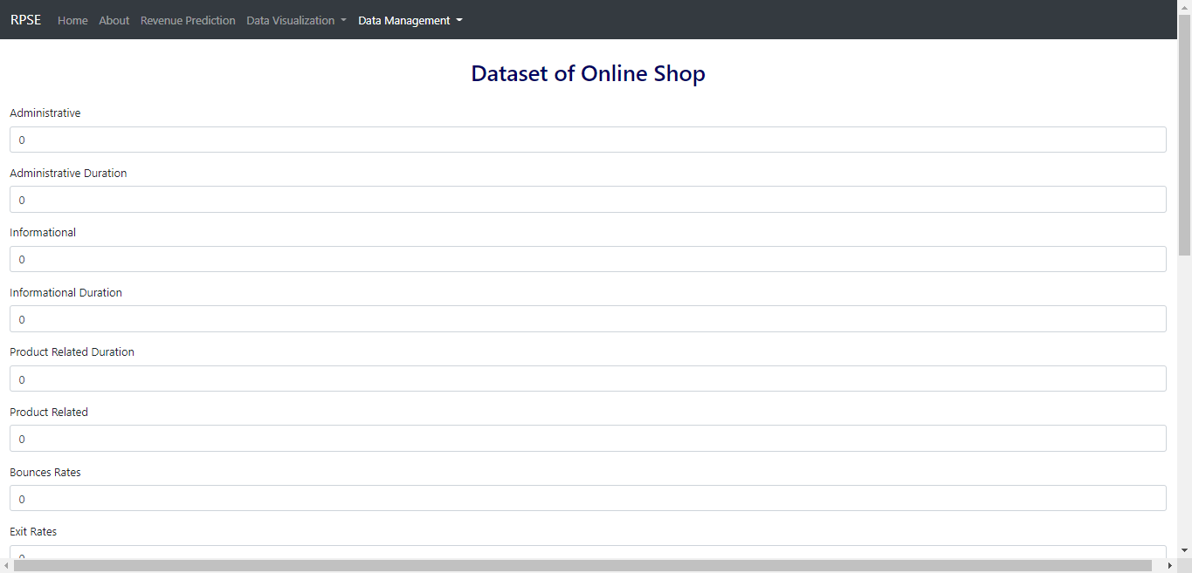
Data Management Interface

Slide 21
Conclusion

Slide 22
Conclusion
CONCLUSION
We can make a new RPSE using the machine learning model random forest classifier. The precision and recall score from the model logistic regression and random forest classifier are better than the other 4 machine learning models.
The random forest classifier was chosen because it has higher AUC score than logistic regression. This model also has the least FP and FN result.
SUGGESTION
For the next future development for RPSE application, we need to prepare
more critical data such as age, gender, time and detail data such as
bounce rates, exit rates, page values per page.

Slide 23
RPSE
Thank you

